Slide 1


Olist Store E-Commerce Analysis
Group 3
Presented by :
Rahul Kumar
Heena Jamal
Kalpana Pattnaik
M Chandrashekar Reddy
Dhanashree Suresh Koli
Mrunal Wanjari
Santhoshi Jante

Slide 2
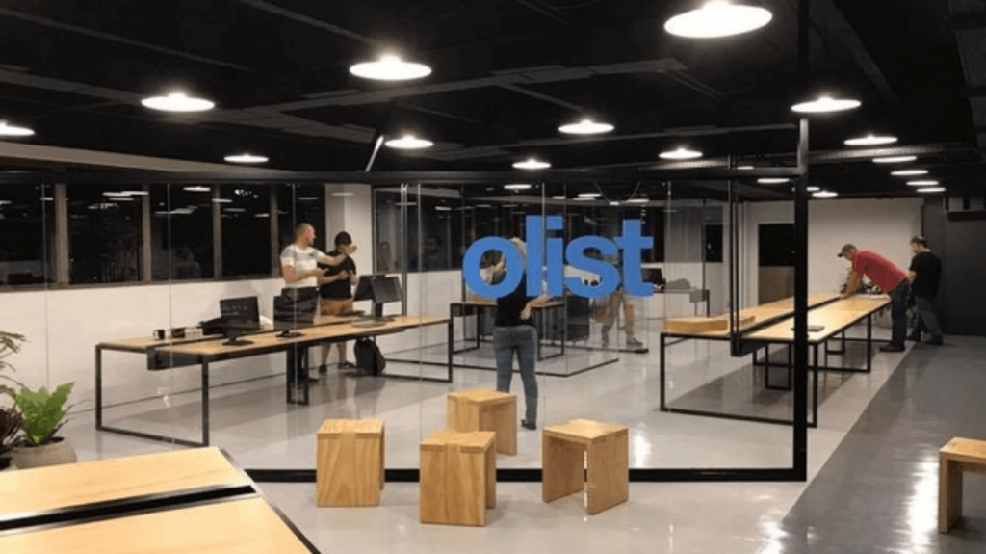
About Olist Store
Olist is a Brazilian startup that operates in the e-commerce segment , mainly through the marketplace. It is well spread within the country.
This project is a detailed analysis on the comprehensive Olist data. The original Olist dataset has information of 100k orders from 2016 to 2018 made at multiple marketplaces in Brazil.
It offers e-commerce marketplace solution to retailers of all sizes to increase their sales.

Slide 3

Data Description
We have been provided with multiple tables in CSV format. Such as
olist_orders_dataset: This dataset has information about the customer and its location. Use it to identify unique customers in the orders dataset and to find the orders delivery location. This table is connected to 4 other tables. It is used to connect all the details related to an order.
olist_order_items_dataset: It contains the details of an item that had been purchased such as shipping date, price and so on.
olist_order_reviews_dataset: It contains details related to any reviews posted by the customer on a particular product that he had purchased.
olist_products_dataset: It contains related to a product such as the ID, category name and measurements.
olist_order_payments_dataset: The information contained in this table is related to the payment details associated with a particular order.
olist_customers_dataset: Details the customer base information of this firm.
olist_geolocation_dataset: It contains geographical information related to both the sellers and customers.
olist_sellers_dataset: This table contains the information related to all the sellers who have registered with this firm.

Slide 4

Relationship Model
With above datasets a schema depicting how these tables are connected. After connecting all the 8 tables, we analyze the entire dataset.

Slide 5




Analysis of Project KPIs
Along with the datasets 5 KPIs are provided for analyzing the data. By using below mentioned tools we finally got the desired analysis out of the given datasets.
KPIs
Weekday Vs Weekend Payment Statistics
Number of Orders with review score 5 and payment type as credit card.
Average number of days taken for order_delivered_customer_date for pet_shop
Average price and payment values from customers of sao paulo city
Relationship between shipping days Vs review scores.
Tools Used:

Slide 6
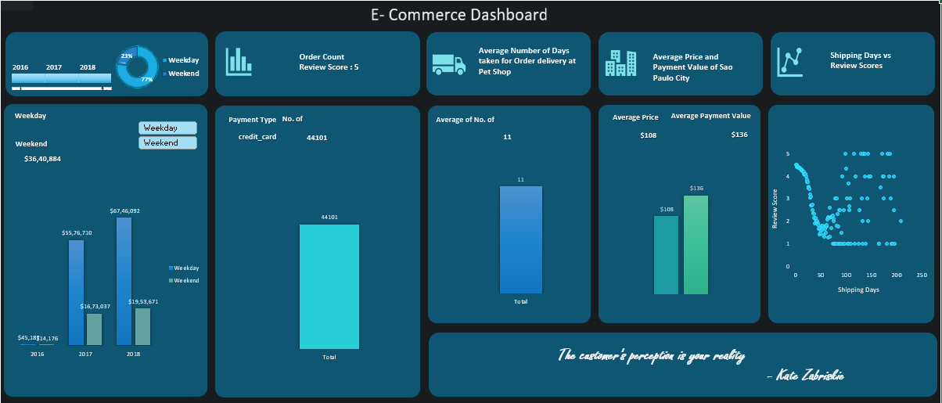
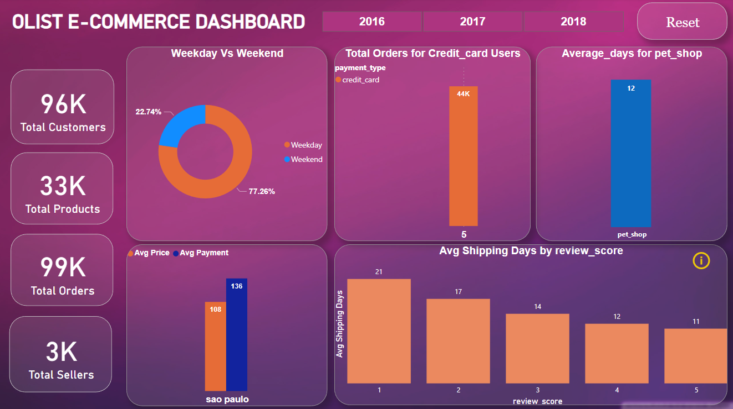
An Overview of Dashboard

Slide 7
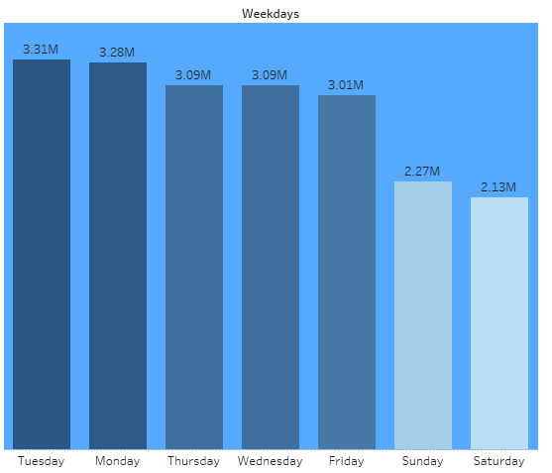
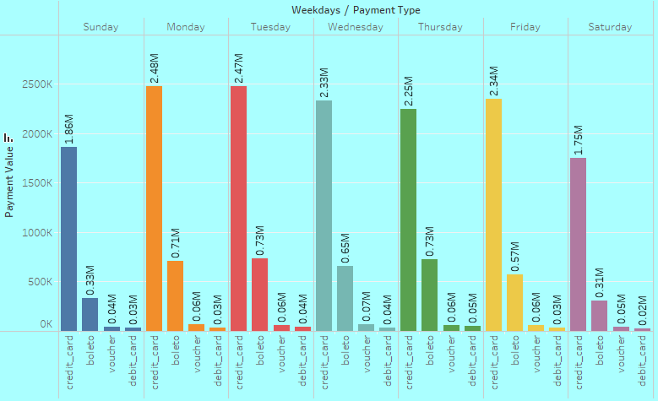
1. Weekday Vs Weekend Payment Statistics
Overview:
Weekday sales – 77% & Weekend sales – 23%
Most of the sales are done on weekdays.
On weekdays major sales happened on Tuesday and on the weekend it’s on Sunday.
The highest number of payments are made through Credit card mode.
Suggestion:
To increase the weekend sales, we can release any special offers on the weekends.

Slide 8
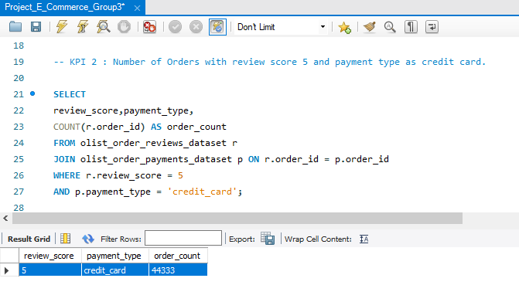
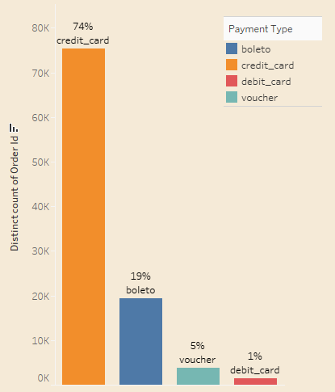
2. Number of Orders with review score 5 and payment type as credit card
Overview:
With a review score of 5 and payment type as a credit card, we have received 44333 orders.
More orders have been placed via credit card payment than boleto, voucher, and debit card payment modes.
More than 70% of sales were paid by Credit Card which is the main payment method in the market. However, payment using Boleto has slightly increased by 7% and a significant increase in using a debit card has been found.

Slide 9
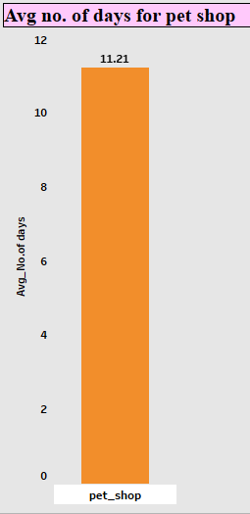
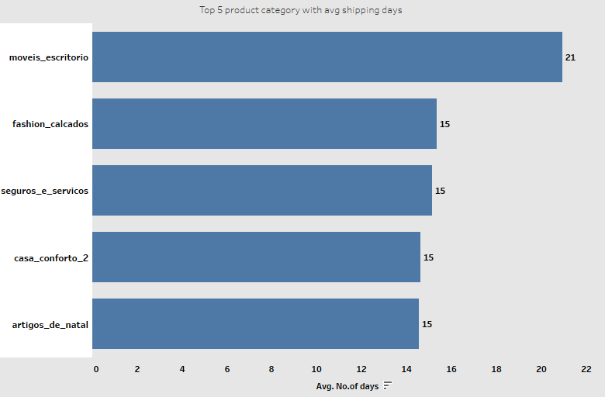
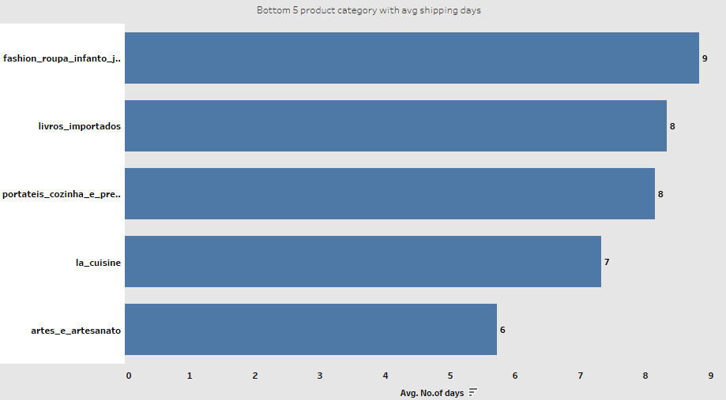
3. Average number of days taken to deliver order for pet_shop
Overview:
11 days is the avg days taken to deliver the order for pet shop.
21 days is the maximum days taken to deliver the order on an average.
6 days is the minimum days taken to deliver the order.
Suggestion:
We can work on faster delivery of the product by taking additional delivery measures.
Our focus should be on the products which are taking more average no. of days to be delivered.

Slide 10
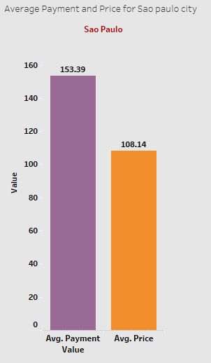
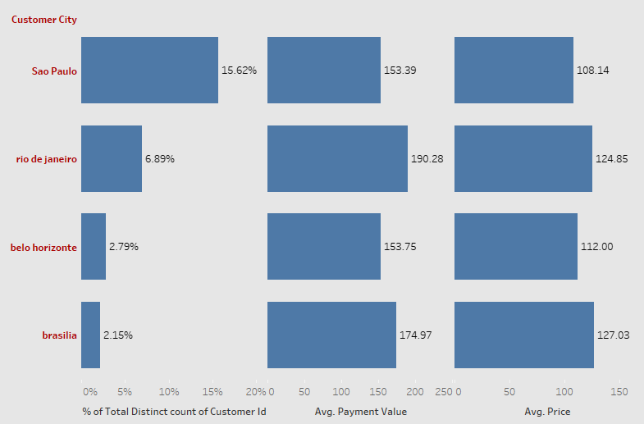
4. Average price and payment values from customers of sao paulo city
Overview:
Sao Paulo City – Avg price is 108 and avg payment is 153
The total number of customers is nearly 100K. We found out that São Paulo contains the most customers and is 2 times more than the second one.
It is expected that São Paulo has particularly the most order payment value, but it is not. When we consider other cities, Rio de Janerio has highest price and payment value.
Either Rio de Janerio (RJ) or Belo Horizonte(BH) takes 10% of total customers.
Suggestion:
To increase sales on other cities we can work on product wise offers.

Slide 11
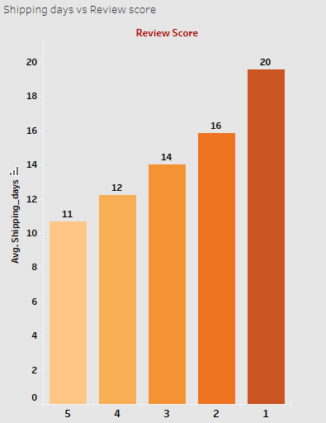
5. Relationship between shipping days Vs review scores.
Overview:
11 avg shipping days taken for review score 5 & 20 avg shipping days taken for review score 1.
We get positive/high ratings when delivery time is less and negative feedback from the customers when it takes long to deliver the product.
Lesser the delivery days – the higher the positive reviews.
Suggestion:
Minimizing the shipping days would lead to more positive reviews. Consecutively customer satisfaction will be met which leads to more business.

Slide 12

Observation
Major sales happened on weekdays(77%) when compared to weekends(23%).
Currently credit cards are the most preferred payment type by customers which contributes a major role in overall sales(78.44%). To improve sales & to promote other payment types, Olist Store can provide discounts & offers on other payment types.
Sellers should improve on delivery days & should keep customers informed about status of delivery it will make time go much faster for customer and will create personalize experience because they know what's happening.
From 5th KPI we can conclude that if sellers take longer days to deliver the product, then customers provide less review score which shows it is one the factor that influences review score.

Slide 13

THANK YOU

